Slide 1
Audio Source Localization as an Input to Virtual Reality Games
MS Project
Agneya A. Kerure

Slide 2
Research Goal
Utilizing live audio and its properties(specially source location) as an input for level generation and/or creation of game objects in a virtual reality environment/game.
Designing games which will be able to utilize this technology.
Collaborative/Social
Intuitive
Engaging/Intriguing
Fun!

Slide 3
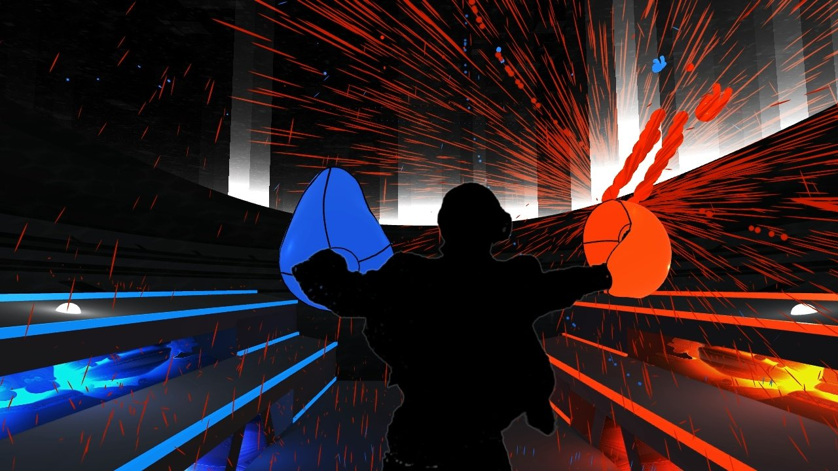
Background
Audio Source Localization: Determining the location of a sound source in a given sound field.
VR and Audio:
Rhythm Games
Rock Band VR
Guitar Hero VR
AudioShield

Slide 4
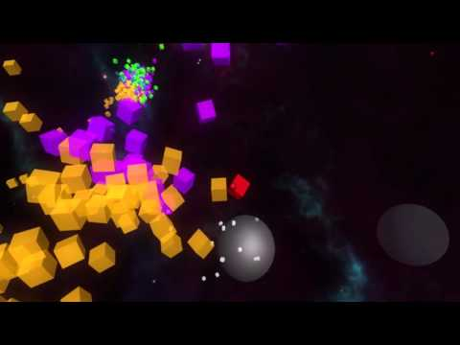
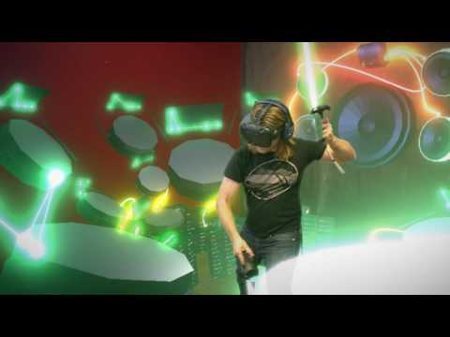
Background cont.
Music Visualizers:
VRock Music Visualizer
Intone- Sing
VR Music Videos and Performances:
VRTIFY - collection of 360 Music Videos
Artists like The Weeknd, Maroon 5 etc.
Composition
SoundStage VR

Slide 5
Why Audio Input
Why not computer vision/RF tagging/GPS?
Because:
Signal Processing to get information! - gender, intonation, speech recognition
Soundscape affecting game environment
Audio is everywhere!

Slide 6
Audio Source Localization
TDOA

Slide 7

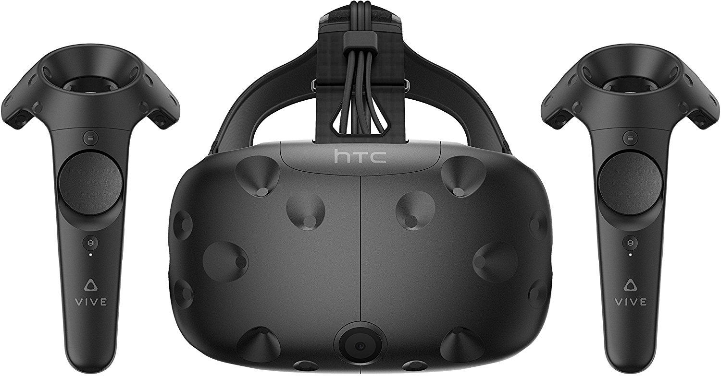
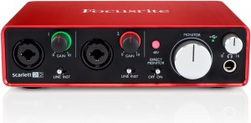
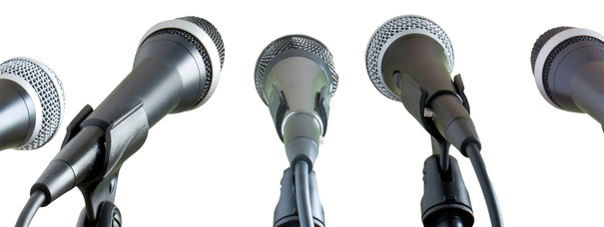
Hardware
HTC Vive/Any VR Headset
Windows PC - Graphics Card
Microphones - two or more
Audio Interface
People

Slide 8

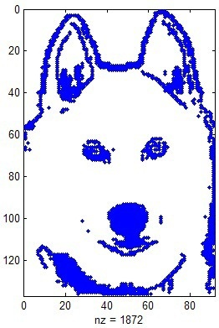

System
Mics/Array -> Audio Interface -> PC -> Unity -> Processing(Localization, Speech Recognition? etc) -> HTC Vive Graphics -> Fun!
Algorithm testing: MATLAB

Slide 9
Game Design
People playing with someone wearing a headset
First Person Shooter:
Shout and create targets for player to aim at
Harry Potter:
Shout Spells at player
Move around and dodge
He/she can block and cast his own spells
Relaxing Zone:
Create rivers, trees, animals, objects by sound
Calming/creative

Slide 10

Game Design
*your ideas

Slide 11
Challenges
Real Time multiple audio source localization - needs more microphones
Designing games which are not boring and weird but fun
Latency
Signal Processing in Unity

Slide 12


